Slide 1

Redshift for Hotels and Motels
Managing your heating and cooling costs whilst supporting your customers.
www.redshiftwireless.com

Slide 2

Redshift Wireless
Redshift Wireless is an innovative business aimed at helping others manage their energy costs
We are Australian based, using locally developed technology
We do this by giving others the tools to make savings in their biggest areas of energy usage
For many businesses, this means we concentrate on heating and cooling
Our products tend to be Internet Connected, allowing us to manage as much of the solution as possible.

Slide 4
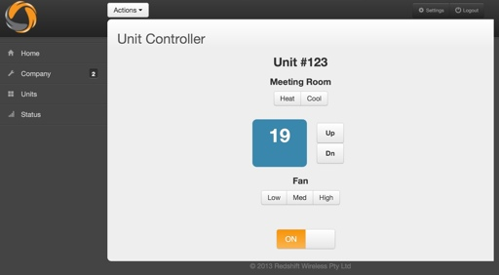
Redshift Climate
Our standard Redshift Climate product is a device that permits almost any IR controlled Air Conditioner to be controlled
You can ‘throw away the remote’ and control them almost anywhere in the world via phone, PC, Laptop or tablet
You can control one or many units at the press of a button

Slide 5
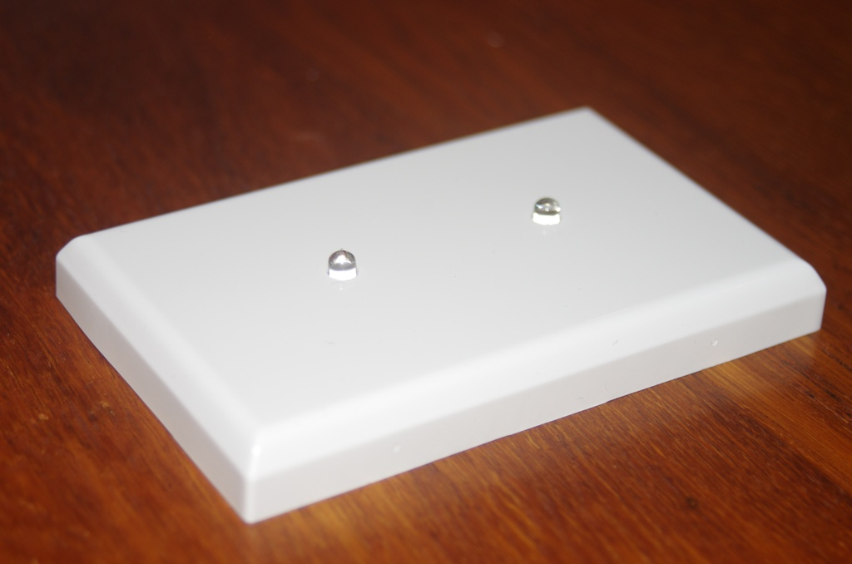
Redshift Climate
The standard Redshift Climate hardware connects via WiFi and just needs to be plugged in to power
It will control just about any Air Conditioner with a Remote Control on the market

Slide 6
Redshift Climate for Hotels
We are about to release three new products for hotels
Tablet Control
Hotel Control Panel
Hotel Remote
(Climate Two)
Tablet Control
With Tablet Control, we provide an Android or Apple tablet for controlling the Air Conditioning
This may appeal to boutique hotels

Slide 7
Redshift Climate for Hotels
Hotel Control Panel
With this product, the standard wall plate gets a display with push button switches and remote receiver
This can either be combined with the standard product or separate for convenience
Hotel Remotes
This is our main offering for Hotels
Named Climate Two
We replace the standard A/C remote with a new unit and limit the settings permitted
The new remote will not work outside the hotel, so theft is less of an issue

Slide 8
Redshift Climate for Hotels - Features
Enforced Settings
You can limit what settings may be used, and what temperatures
You may for example prohibit anything but a low fan, or heating above 25C
You can even lock the AC off if desired
One Remote
All your A/C units will now use the same remote, even if they are different makes and models
The remote will be less expensive to replace than the dedicated units

Slide 9
Redshift Climate for Hotels - Features
Energy Saving
Implement rules like A/C off at Checkout from the office
Possibly force all devices off after three hours, requiring users to turn them back on
Warn when filters might need cleaning, saving 5-15%
Comfort
Automatically turn on the A/C at Check In for comfort
Turn on a customers A/C on Wake Up Call

Slide 10
Redshift Climate for Hotels - Features
Monitoring
Monitor A/C use from the office, and override if required.
Internet based, so no software needs to be installed
Control any or all of the units all at once.
New Features
Want to integrate with your room management software or need a new feature? No problem.
Just Ask!

Slide 11
Redshift Climate for Hotels - Requirements
Requirements
A/C units with IR Remotes
WiFi with Internet Access in rooms with good signal strength
You do not need to offer this access to Guests, but this equipment does need access
You should always keep your old remotes in case your Internet is lost for some reason.

Slide 12

Conclusion
Redshift Wireless is here to help you solve your problems.
Have a question – Just ask and we will do our best to meet your needs.

Slide 13

Contact Details
Darryl Smith

